Slide 1
COMPILER CONSTRUCTION

Slide 2
Why study compilers?
Be able to build a compiler for a (simplified) (programming) language
Be familiar with assembly code and virtual machines
Be able to define LL(1), LL(k) grammars
Be familiar with compiler analysis and optimization techniques
Working with really big data structures
Complex interactions between algorithms
Experience with large-scale applications development
Help you out on your next big programming project.

Slide 3
More details about the course
How do computers work?
(instruction set, registers, addressing modes, run-time data structures, ...)
How do compilers work?
What machine code is generated for certain language constructs?
What is good language design?

Slide 4
Course Outline
Functions of a Language Processor
The Phases of a Compiler
Generative Grammar
BNF and Syntax Diagrams
Scanner and Symbol Table
Top Down Parsing with Backtracking
Predictive Parsing
LL(k) Grammars

Slide 5
Course Outline
Recursive Descent Parsing
The Parser of KPL
Semantic Analysis
Stack calculator
Intermediate Code Generation
Object Code Generation
Code optimization

Slide 6
Textbooks
Aho.A.V, Sethi.R., Ullman.J.D.
Compiler : Principles, Techniques and Tools.
Addison Wesley.1986
Bal.H. E.
Modern Compiler Design.
John Wiley & Sons Inc (2000)
William Allan Wulf.
The Design of an Optimizing Compiler
Elsevier Science Ltd (1980)
Charles N. Fischer.
Crafting a Compiler
Benjamin-Cummings Pub Co (1987)

Slide 7
Text books
Niklaus Wirth
Compiler Construction.
Addison Westley. 1996
Andrew.W.Appel
Modern Compiler Implementation in Java
Princeton University.1998
Nguyễn Văn Ba
Techniques of Compiling (in Vietnamese)
Hanoi University of Technology1994
Vũ Lục
Parsing(in Vietnamese)
Hanoi University of Technology1994
www.sourceforge.net

Slide 8
Unit 1. Functions of a Language Processor

Slide 9
High Level Programming Languages
Programming languages have taken 5 generation
A language is considered high or low level depending on its abstraction
A high level language may use natural language elements, be easier to use, or more portable across platforms
Low level languages are closer to the hardware

Slide 10
The first and the second generation
The first generation: machine language
The second generation : Assembly
Languages of the first and the second generation are low level languages

Slide 11
The Third Generation
Easier to read, write and maintain
Allow declarations
Most 3GLs supports structured programming
Examples: Fortran, Cobol, C, C++, Basic . . . .

Slide 12
The Fourth Generation
Designed with a specific purpose in mind, such as the development of commercial business software
Reduce programming effort, cost of software development
May include form or report builder
Examples :SQL, Visual Basic, Oracle (SQL plus, Oracle Form, Oracle Report). . . .

Slide 13
The Fifth Generation
Based around solving problems using constraints given to the program, rather than using an algorithm written by a programmer
Are designed to make the computer solve a given problem without the programmer
Most constraint-based and logic programming languages and some declarative languages are fifth-generation languages.

Slide 14
Characteristics of high level languages
Hardware independence
Close to natural languages
Easy to read, write and maintain
Programs written in a high-level language must be translated into machine language
Often result in slower execution speed, higher memory consumption

Slide 15
Syntax and Semantics of Programming Languages
Syntax:The way symbols can be combined to create well-formed sentence (program) in the language
Semantics: The meaning of syntactically valid strings in a language

Slide 16
Language Processors
A program that performs tasks, such as translating and interpreting, required for processing a specified programming language.For example,
Compiler
Assembler
Interpreter
Compiler - Compiler

Slide 17
Language Translation
Native-code compiler: produces machine code
Compiled languages: Fortran, C, C++, SML …
Interpreter: translates into internal form and immediately executes (read-eval-print loop)
Interpreted languages: Scheme, Haskell, Python …
Byte-code compiler: produces portable bytecode, which is executed on virtual machine (e.g., Java)
Hybrid approaches
Source-to-source translation (early C++ → C→compile)
Just-in-time Java compilers convert bytecode into native machine code when first executed

Slide 18
Language Compilation
Compiler: program that translates a source language into a target language
Target language is often, but not always, the assembly language for a particular machine
C
source code
C
compiler
x86 ASM
x86
assembler
Pentium op codes

Slide 19
Checks During Compilation
Syntactically invalid constructs
Invalid type conversions
A value is used in the “wrong” context, e.g., assigning a float to an int
Static determination of type information is also used to generate more efficient code
Know what kind of values will be stored in a given memory region during program execution
Some programmer logic errors
Can be subtle: if (a = b) … instead of if (a == b) …

Slide 20
Compilation Process
Syntax and static
type errors
Lexical analyzer
tokens
Syntax analyzer + type checker
ASTs
Intermediate
code gen
IC
IC_{opt}
Final code gen
Optimizer
raw source
code text
ASM
Assembler
Preprocessor
Source code with
preprocessor directives
Machine code

Slide 21
Phases of Compilation
Preprocessing: conditional macro text substitution
Lexical analysis: convert keywords, identifiers, constants into a sequence of tokens
Syntactic analysis: check that token sequence is syntactically correct
Semantic Analysis: Generate abstract syntax trees (AST), check types
Intermediate code generation: “walk” the ASTs (or Parse Trees) and generate intermediate code
Apply optimizations to produce efficient code
Final code generation: produce machine code

Slide 22
Language Interpretation
Read-eval-print loop
Read in an expression, translate into internal form
Evaluate internal form
This requires an abstract machine and a “run-time” component (usually a compiled program that runs on the native machine)
Print the result of evaluation
Loop back to read the next expression
input expression
REPL interpreter
result
Interpreter
runtime

Slide 23
Bytecode Compilation
Combine compilation with interpretation
Idea: remove inefficiencies of read-eval-print loop
Bytecodes are conceptually similar to real machine opcodes, but they represent compiled instructions to a virtual machine instead of a real machine
Source code statically compiled into a set of bytecodes
Bytecode interpreter implements the virtual machine
Bytecode compiler
Bytecode interpreter
result
source
program
bytecodes
Virtual machine
runtime

Slide 24
Binding
Binding = association between an object and a property of that object
Example: a variable and its type
Example: a variable and its value
A language element is bound to a property at the time that property is defined for it
Early binding takes place at compile-time
Late binding takes place at run-time

Slide 25
Compilers vs Interpreters
A compiler or an interpreter is a computer program (or set of programs) that converts program written in high-level language into machine code understood by the computer

Slide 26
Compilers
Scans the entire program and translates it as a whole into machine code.
Takes large amount of time to analyze the source code but the overall execution time is comparatively faster.
Generates the error message only after scanning the whole program.
Programming language like C, C++ use compilers.
Input
Source
Program
Compiler
Target
Program
Error messages
Output

Slide 27
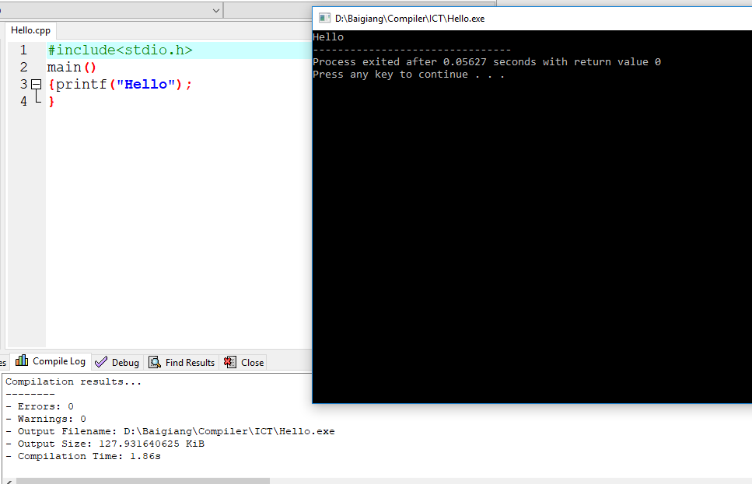
C translator: compiler

Slide 28
Compilers (cont’d)
The most common reason for wanting to transform source code is to create an executable program.
To run a program, execute the compiler (and possibly an assembler) to translate the source program into a machine language program.
Execute the resulting machine language program, supplying appropriate input.

Slide 29
Interpreters
Translates program one statement at a time
Takes less amount of time to analyze the source code but the overall execution time is slower.
Continues translating the program until the first error is met, in which case it stops.
Programming language like Python, Ruby use interpreters.
Oversimplified view:
Source
Program
Interpreter
Output
Input
Error messages

Slide 30
Interpreters (cont’d)
Accepts the source language program and the appropriate input
Itself produces the output of the program.

Slide 31
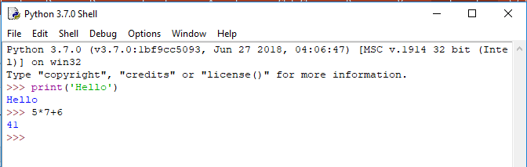
Python translator: interpreter
Python command window

Slide 32
Interpreter as a part of compiler
In a compiler implementations
The source code is compiled to a machine language for an idealized virtual machine
The interpreter of accepts the codes and the input, produces the output.
This technique is quite popular to make the compiler independent with the computer

Slide 33
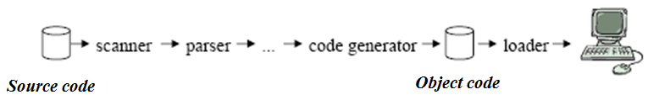
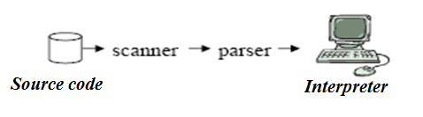
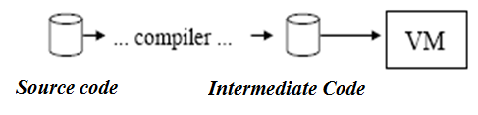
Compilers and Interpreters (cont’d)
A Compiler is a program that translates code of a programming language into machine code (assembly)
An interpreter translates some form of source code into a target representation that it can immediately execute and evaluate
Modification of Interpreter :a program that implements or simulates a virtual machine using the base set of instructions of a programming language as its machine language

Slide 34
Cousins of the compiler
Interpreter
Assembler
Linker
Loader
Preprocessor
Editor
Debugger
Profiler

Slide 35
The context of a compiler in a language processor
Skeletal Source Program
Preprocessor
Source Program
Compiler
Target Assembly Program
Assembler/Interpreter
Relocatable Object Code
Linker+Loader
Libraries and
Relocatable Object Files
Absolute Machine Code

